Slide 1
Welcome! [Insert the name of your course] [Insert instructor name]
Notes:
Welcome to class!
Participate in some quick icebreakers to get your familiar with Engageli and learn something about each other.

Slide 2
If you’ve heard of Engageli before today.
Notes:
Direct the students to the React button

Slide 3
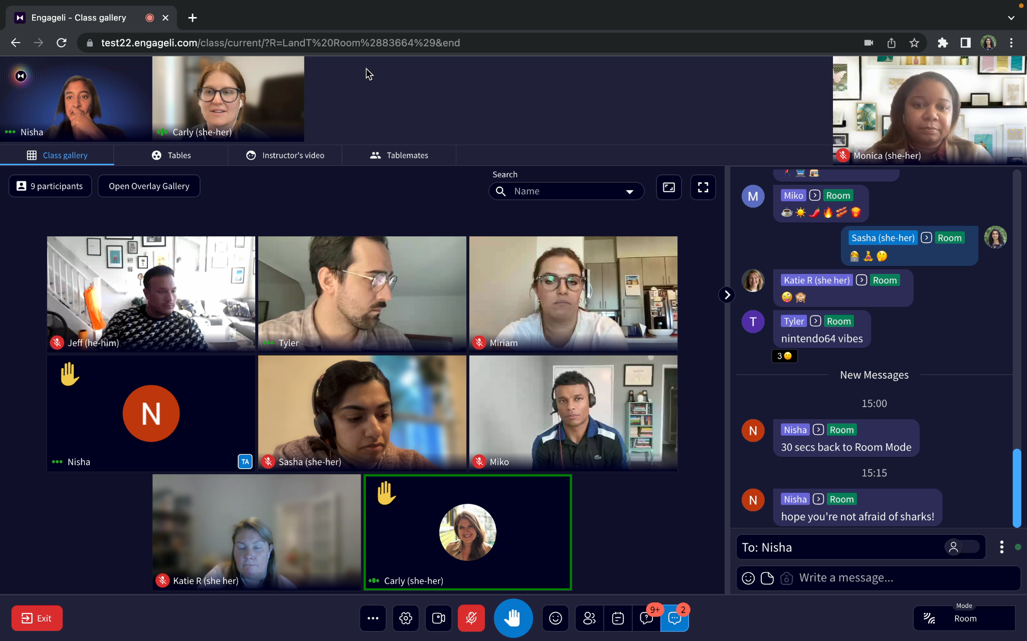
You are heard by all at the Podium here
Instructor
Click the person icon for your tablemates.
Click the notepad icon to access your personal notepad (can screenshot shared materials)
Click the ? bubble icon to access the Q&A
Click … bubble icon to message anyone (or everyone!)
Notes:
Quick orientation to the classroom we’re in – it’s a little bit different than Webex that we’re used to, so we can better collaborate and learn together.
The default view is Class Gallery, which is likely something you’re familiar with (you can see all other participants, though you won’t see yourself, to prevent virtual fatigue).
If you look directly under my video, you’ll see a few tabs or features that can help you communicate and stay engaged:
Table tab shows you who all is at your table
Notes for your personal, private notepad, which you can use over the course of all attended sessions
Chat to message anyone and also share links or files
Q&A to post questions and share your answers
Click the Raise Hand button -- bottom / center – that brings you up to the podium where everyone can see and hear you, regardless of the audio mode - ask Kim to raise hand to demonstrate
You can also indicate non-verbally by clicking the Thumbs up or down button – to the right of the Raise Hand button
Anything you need, raise your hand to ask, or put it in the chat or Q&A – navigate to the Q&A now to answer our prepared question

Slide 4
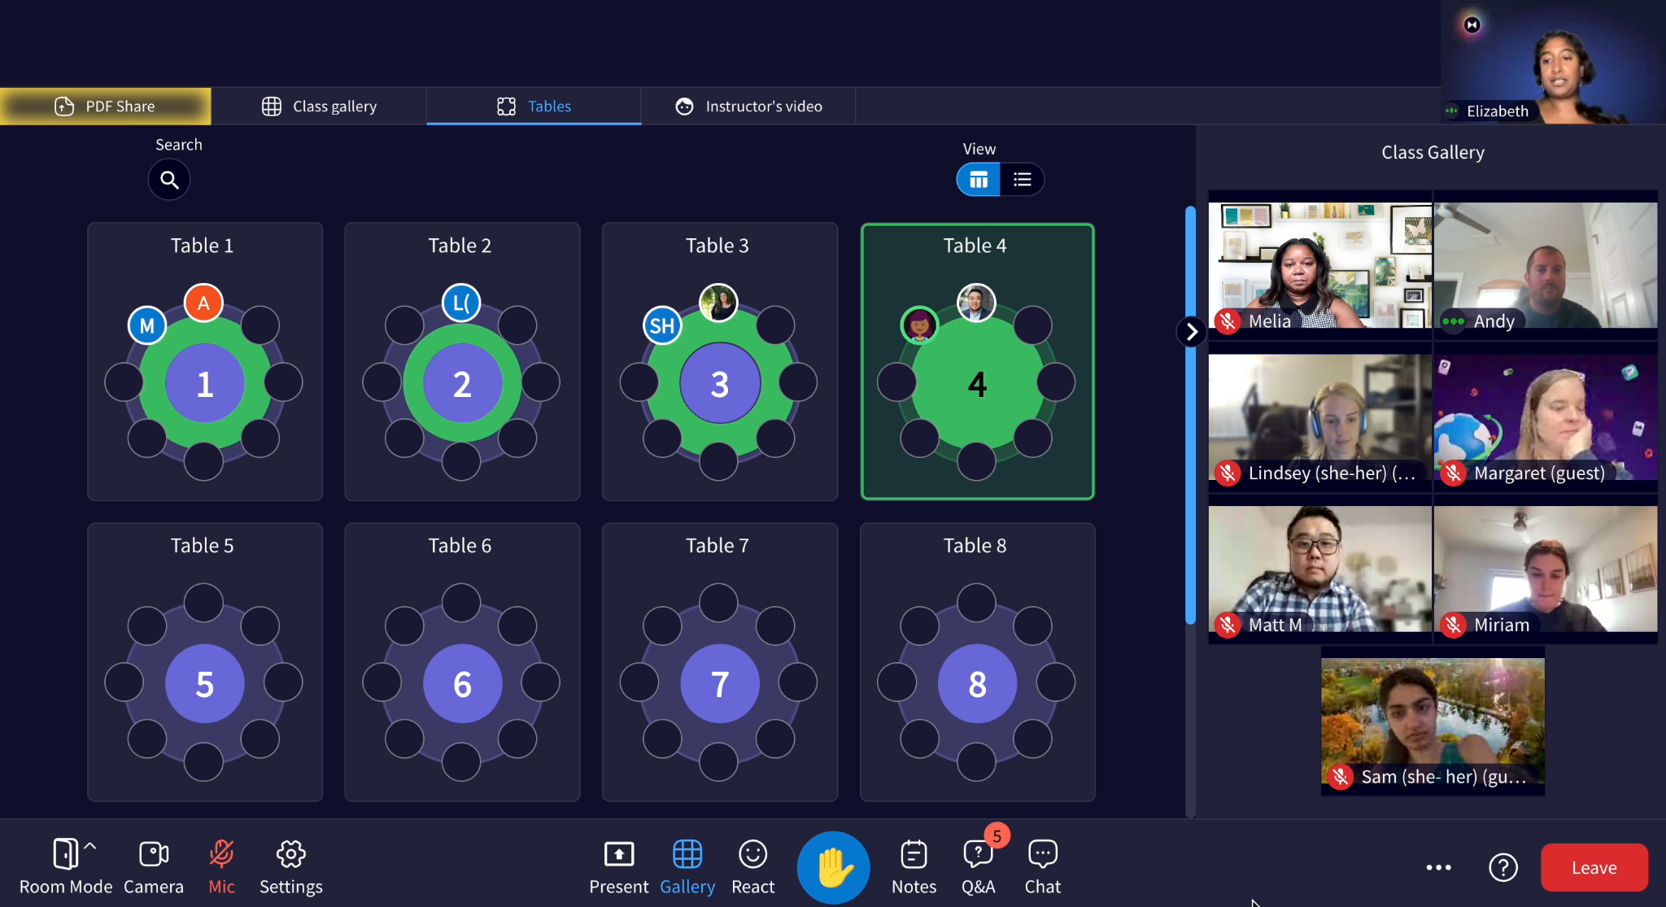
Change your view here without affecting others
Hover over the mode to see who can hear you here
Notes:
If you click the carrot next to “My View” you can shift your view to Tables (changing your view doesn’t affect anyone else’s view). You’ll see that you’re all seated at one of these tables, even as we’re in one virtual room together.
We’re currently in Room mode, so if you hover your mouse over “Mode” in the bottom right corner, you can see that everyone can hear everyone else. At certain times over the course of the session, I’ll shift the audio to Table mode, which you see in the bottom / right corner of your screen. Just like in a large room where you’re at a table, in Table Mode, you can simply start talking to folks at your table and you won’t be heard by me or participants at the other tables.

Slide 5
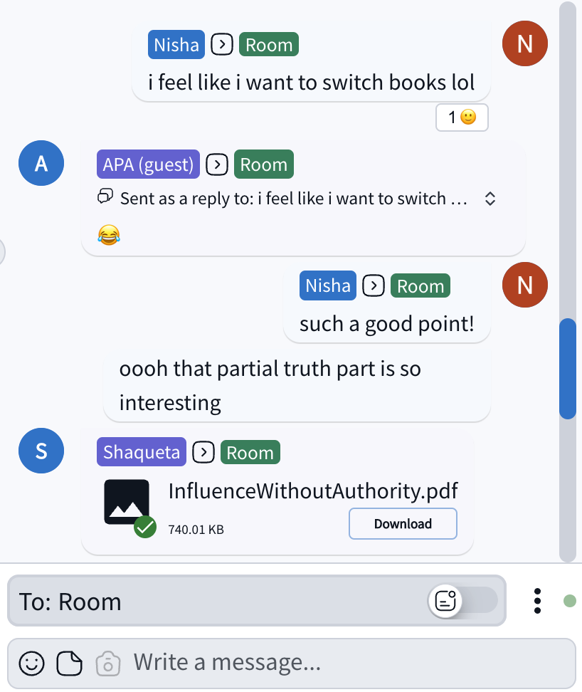
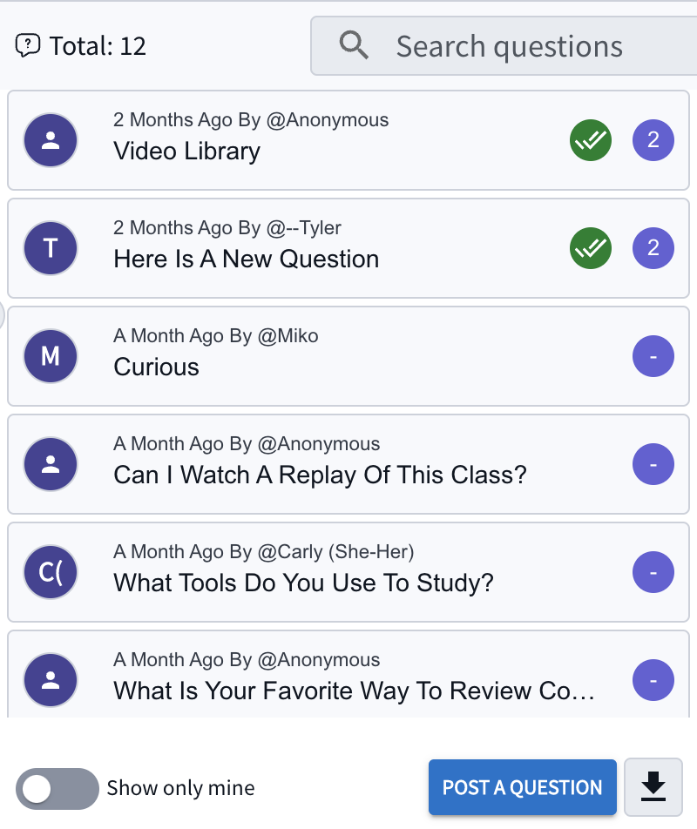
Communication and Collaboration Tools
CHAT
Q&A
Collaborate with peers and instructors in the integrated multi-channel chat system
1:1
Instructors
Tablemates
Everyone
Q&A with threaded Discussions
Class-wide persistent threaded Q&A
Named and anonymous Q&A

Slide 6
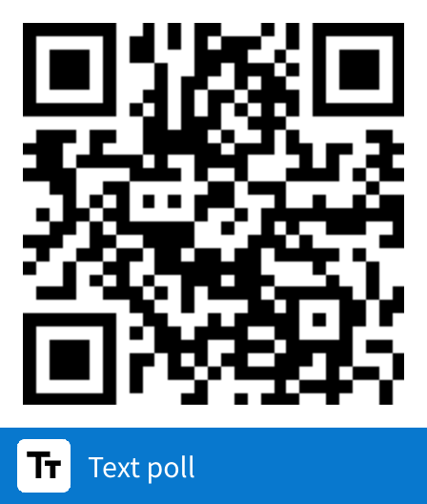
Where are you located? [20 character max]

Slide 7
What are you hoping to learn in this course (in one word)?
(20 characters max)

Slide 8
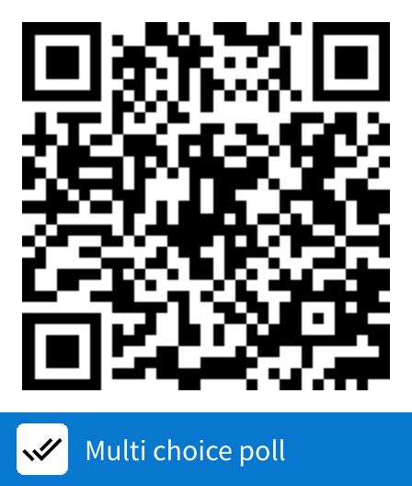
How do you learn best? Select all that apply
Alone, in a quiet spot
With background noise like chatter or music
With others, discussing content
In a lecture
When teaching others

Slide 9
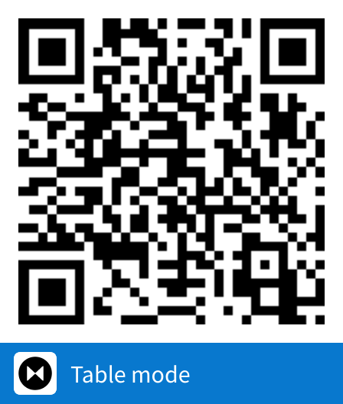
3 minute share
Discuss with your table: Why did you choose those answers and what is your biggest challenge in learning?

Slide 10
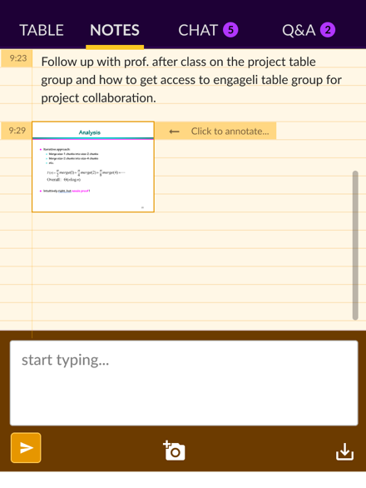
Think Time (3 minutes)
Consider the idea of completely asynchronous class sessions. What are the pros and cons?
Jot down your thoughts in the Notes tab.
Notes:
OUTLINE
Intro slide — heavy on l&t background, early looks, dev k-12, this change
Evolution of edu slide … tmw too late, digital transformation
Moved quickly to online
Time to be thoughtful
Challenges
for instructors
MOTIVATING AND ENABLING ACTIVE, APPLIED LEARNING
Creating an active learning experience requires a different mindset and skill set than lecturing, as it is not simply sharing new knowledge with learners but providing the opportunity for them to create and/or apply that new knowledge themselves.
SUPPORTING ALL LEARNERS MEANINGFULLY
Developing an inclusive learning space is about ensuring that all learners can fully participate, regardless of where or how they’re connecting with the class.
MINIMIZING OPERATIONAL LOAD
Effective teaching - creating an effective learning environment - is hard. Period. Doing so in multiple environments (online, in-person, hybrid, synchronous, asynchronous) is enough to make us crazy. Technology can, and should, carry some of that load.
For learners
ACCESSING SUPPORTIVE ACTIVE, APPLIED LEARNING
Learning science has shown that active learning, in which learners engage to build and apply new knowledge, supports more effective learning.
MAKING MEANINGFUL CONNECTIONS
Strong learning communities not only support an individual’s learning through peer instruction, but also their perseverance in the face of challenges. Additionally, a key outcome of many learning experiences is the network developed throughout.
FINDING FLEXIBILITY, WITH CAMARADERIE
The ability to learn wherever you are, in the time you can dedicate to learning, is critical to enabling all learners to take ownership
Strategies
Keep learning in small groups to foster peer-to-peer learning and community
Image: table
Use frequent formative assessments to evaluate understanding and foster learning (circle back then small group convo)
Image: poll w/results
Use real-time feedback to adjust teaching approach
Image: data
Give students flexibility -
in when and how they communicate with you, and each other //
Access class when it works for them (e.g., hybrid) // participation
Multi-modal diagram
Use data to assess participation and engagement
larger scale iteration image?
Support all students equally, regardless of circumstance

Slide 11
Add Pros and Cons (5 minutes)
Work with your tablemates to add sticky notes to the board, detailing the pros and cons of offering completely asynchronous class sessions
(Click the top tool to open and type on a sticky note)
Notes:
OUTLINE
Intro slide — heavy on l&t background, early looks, dev k-12, this change
Evolution of edu slide … tmw too late, digital transformation
Moved quickly to online
Time to be thoughtful
Challenges
for instructors
MOTIVATING AND ENABLING ACTIVE, APPLIED LEARNING
Creating an active learning experience requires a different mindset and skill set than lecturing, as it is not simply sharing new knowledge with learners but providing the opportunity for them to create and/or apply that new knowledge themselves.
SUPPORTING ALL LEARNERS MEANINGFULLY
Developing an inclusive learning space is about ensuring that all learners can fully participate, regardless of where or how they’re connecting with the class.
MINIMIZING OPERATIONAL LOAD
Effective teaching - creating an effective learning environment - is hard. Period. Doing so in multiple environments (online, in-person, hybrid, synchronous, asynchronous) is enough to make us crazy. Technology can, and should, carry some of that load.
For learners
ACCESSING SUPPORTIVE ACTIVE, APPLIED LEARNING
Learning science has shown that active learning, in which learners engage to build and apply new knowledge, supports more effective learning.
MAKING MEANINGFUL CONNECTIONS
Strong learning communities not only support an individual’s learning through peer instruction, but also their perseverance in the face of challenges. Additionally, a key outcome of many learning experiences is the network developed throughout.
FINDING FLEXIBILITY, WITH CAMARADERIE
The ability to learn wherever you are, in the time you can dedicate to learning, is critical to enabling all learners to take ownership
Strategies
Keep learning in small groups to foster peer-to-peer learning and community
Image: table
Use frequent formative assessments to evaluate understanding and foster learning (circle back then small group convo)
Image: poll w/results
Use real-time feedback to adjust teaching approach
Image: data
Give students flexibility -
in when and how they communicate with you, and each other //
Access class when it works for them (e.g., hybrid) // participation
Multi-modal diagram
Use data to assess participation and engagement
larger scale iteration image?
Support all students equally, regardless of circumstance

Slide 12
Introducing Engageli
Online Learning that is even more engaging than in-person

